Slide 1
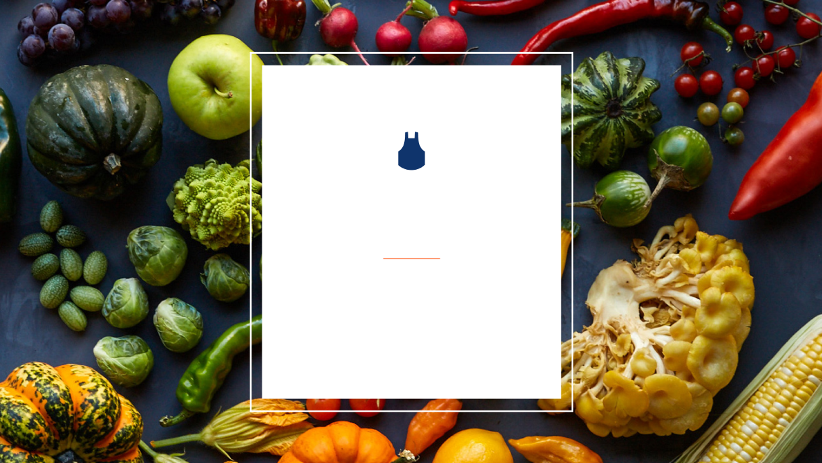
Blue Apron Steering Committee #2
May 10, 2019
Prepared by: Carmin Ballou, Helen Wang, Sasha Roberts, Richard Johnson
Notes:
Carmin
Default font: Arial; 20
Default color of text box: RGB(127,127,127)

Slide 2

Agenda
Identifying Opportunities
Questions Asked
Key Issues
Value Chain
Our Approach
Opportunity Evaluation Process
Opportunity Scoring Method
Opportunity Discovery
(1) Customer Acquisition Dashboards
(2) Cancellation Prediction
(3) Recommendation System
Decision: Recommendation System is the best option
Executive Summary
Notes:
Carmin

Slide 3
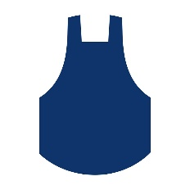
Identifying Opportunities
Notes:
Nick

Slide 4
We asked ourselves 4 questions:
What is Blue Apron doing today?
What are the weaknesses?
What do we propose?
How does this improve the business?
Identify
Our Approach
Discovery
Decision
Summary
Notes:
Carmin

Slide 5
Blue Apron’s value chain reveals analytics opportunities
Infrastructure
Corporate • Technology • Fulfillment
Human Resource Management
Talent Acquisition • Operational Excellence
Support Activities
Technology Development
Supply Chain Engineering • App & Website • Enterprise Systems
Procurement
Farms • Vineyards • Importers
MARGIN
Inbound Logistics
Operations
Outbound Logistics
Marketing & Sales
Service
Sourcing & bulk purchasing
Refrigeration & storage
Damaged goods
Supply-chain partners
Sanitation and safe food practices
Inventory control
Warehouse safety
Warehouse efficiency
Packaging
Sustainability
Labor optimization
Automation
Repackaging
Boxing
Shipping
Delivery
Supply-chain partners
Brand identity
Pricing
Retail & brand partnerships
Marketing channels
Customer acquisition
Customer segmentation
Customer retention
Storytelling
Mobile ordering
Recipe offerings
Brick-and-mortar retailers
Quality, reliable distribution pipeline
Brand partnerships
Quality assurance
Help center & customer assistance
Primary Activities
Identify
Our Approach
Discovery
Decision
Summary
Notes:
Carmin:
blah, blah. you may notice that certain ideas are highlighted. those are the focus of today’s presentation. But, why did we chose those?

Slide 6
What are Blue Apron’s key issues?
Threat of Substitutes
High Cost of
Customer Acquisition
Customer Retention
Value Proposition
Complex Supply Chain & Logistical Issues
Identify
Our Approach
Discovery
Decision
Summary
Notes:
Value Added/Proposition - enhancement a company gives its product or service before offering it to customers

Slide 7
Our Approach
Notes:
Nick

Slide 8
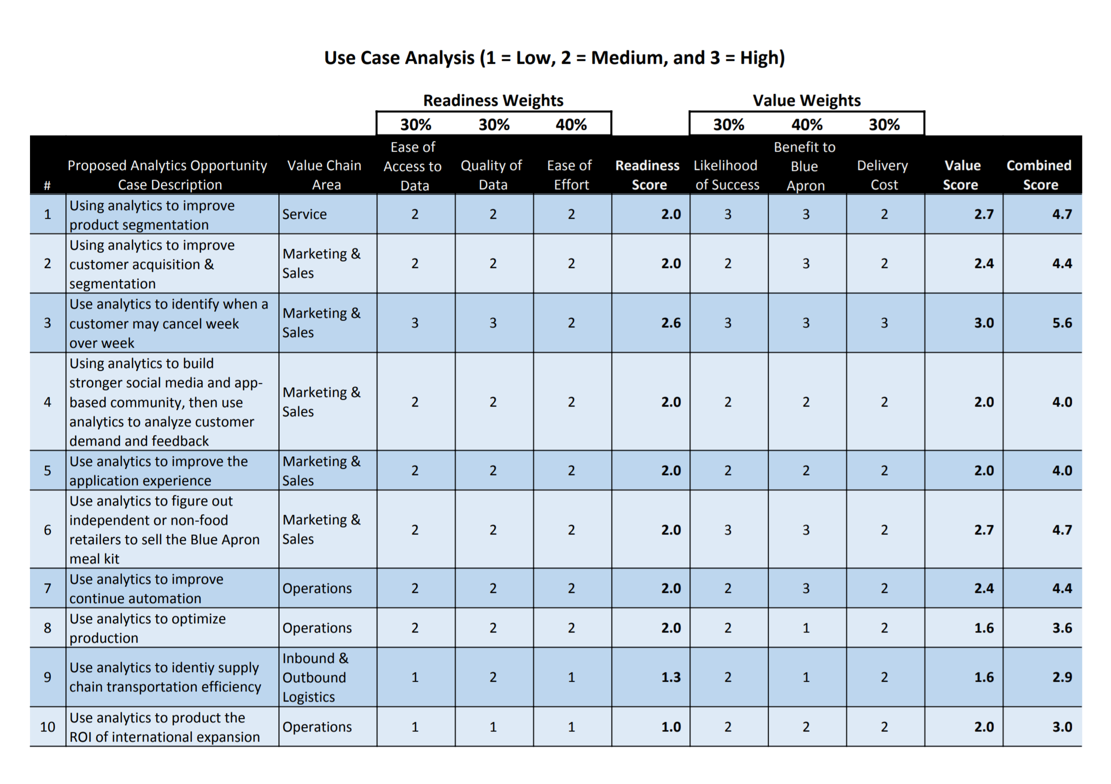
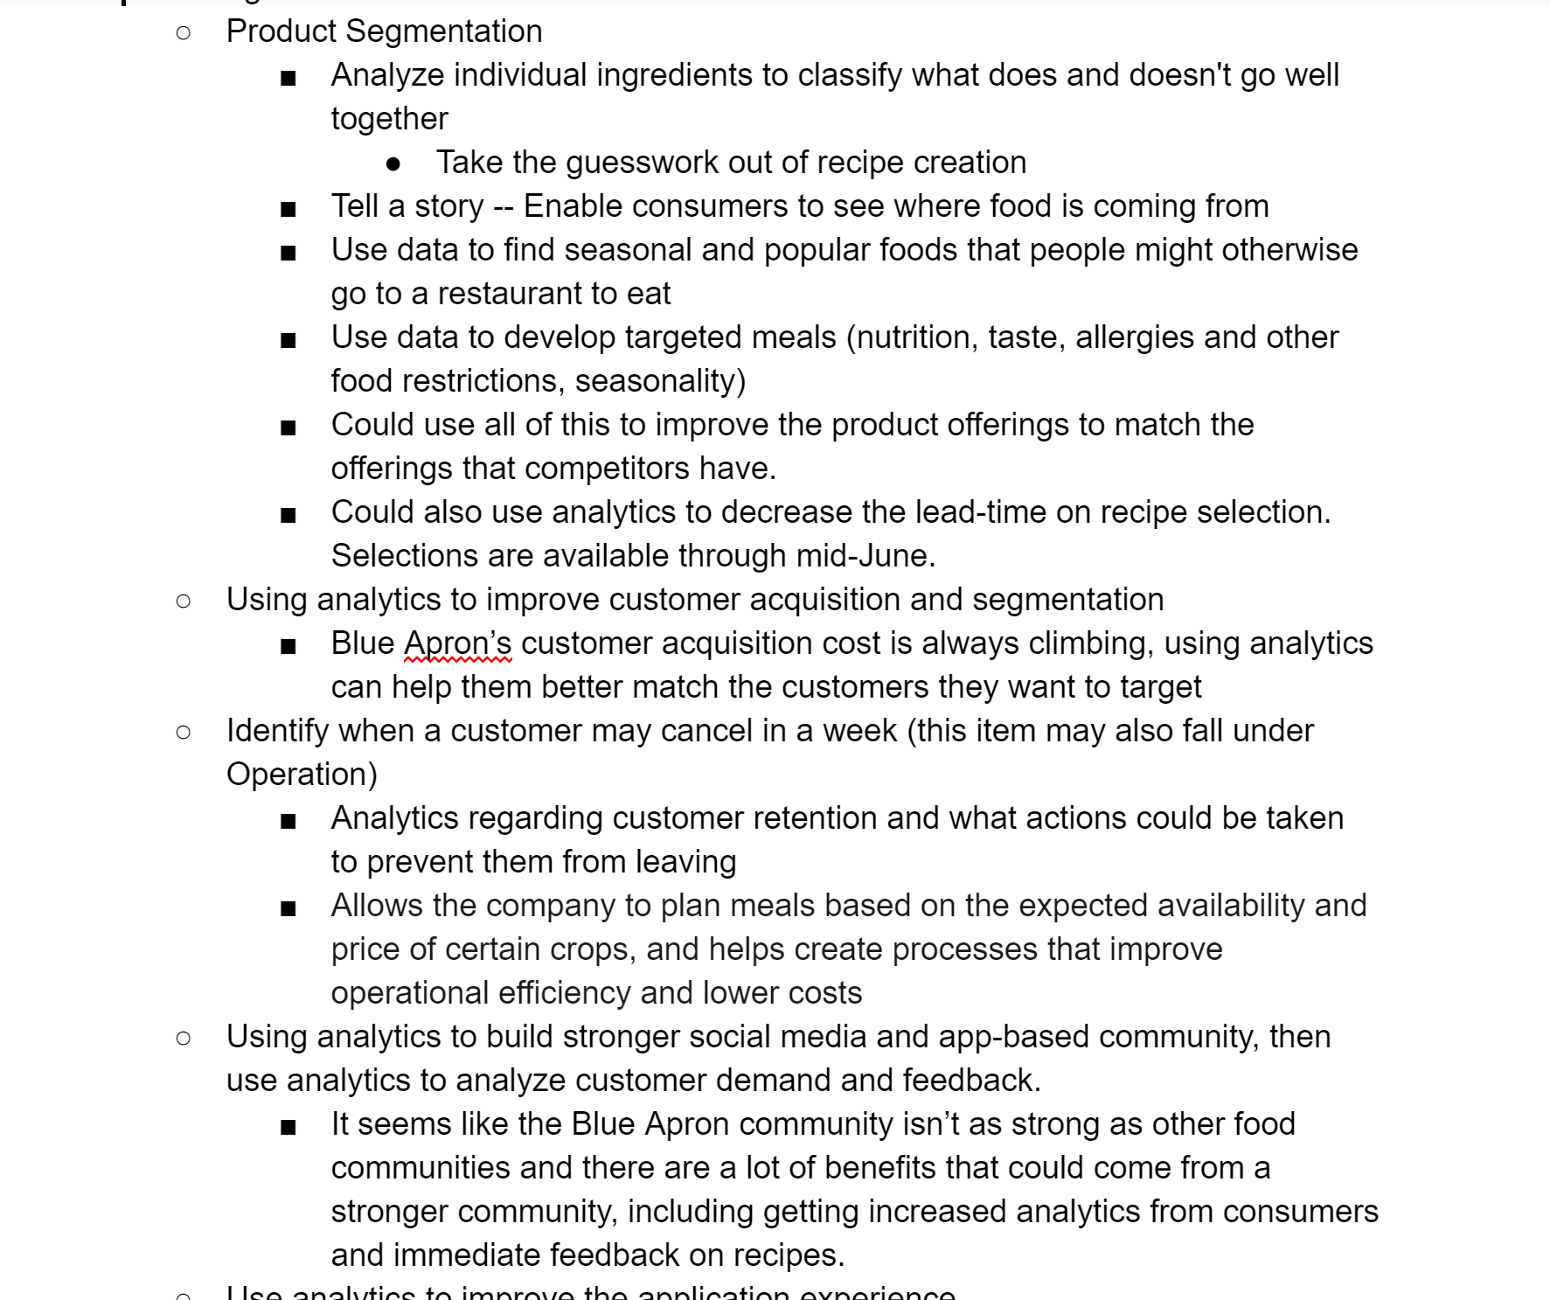
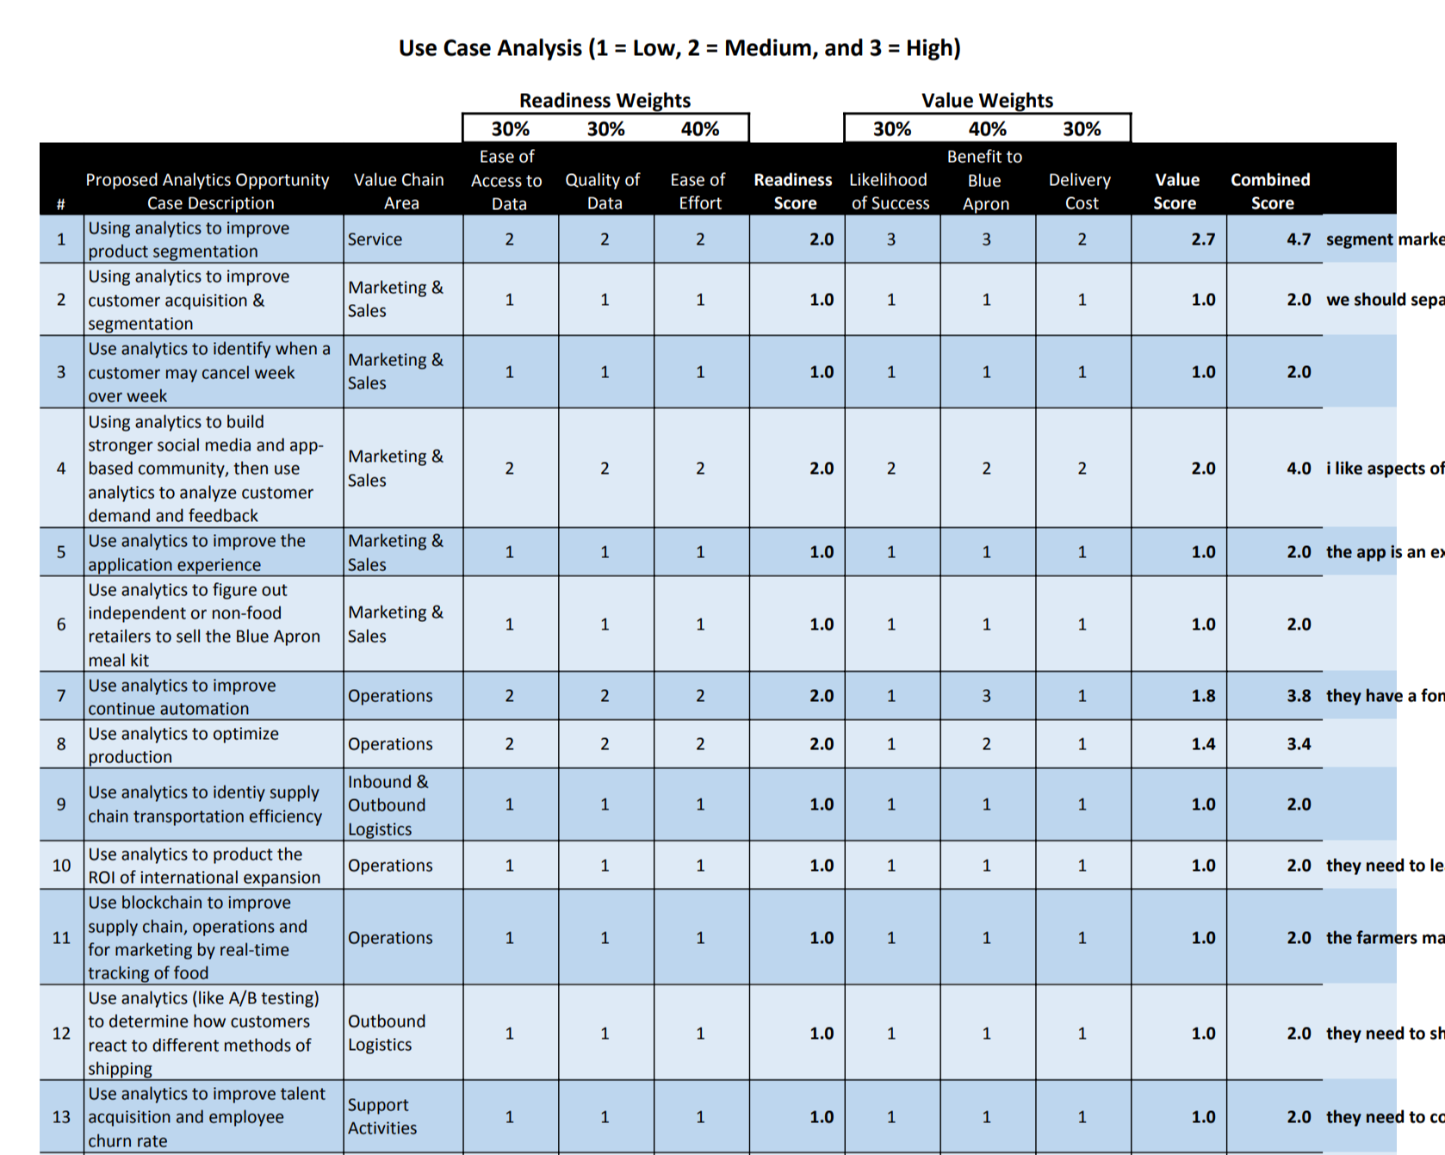
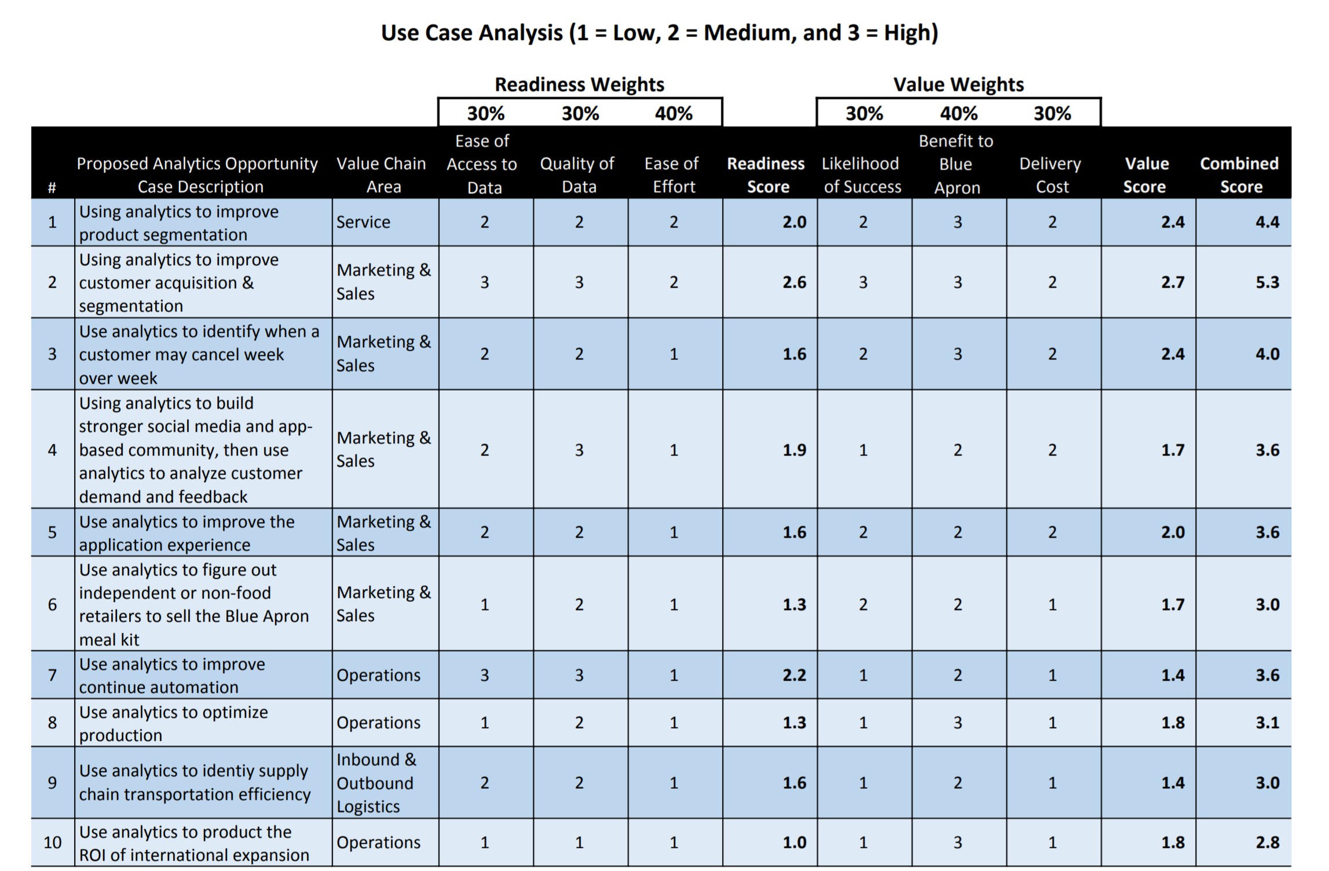
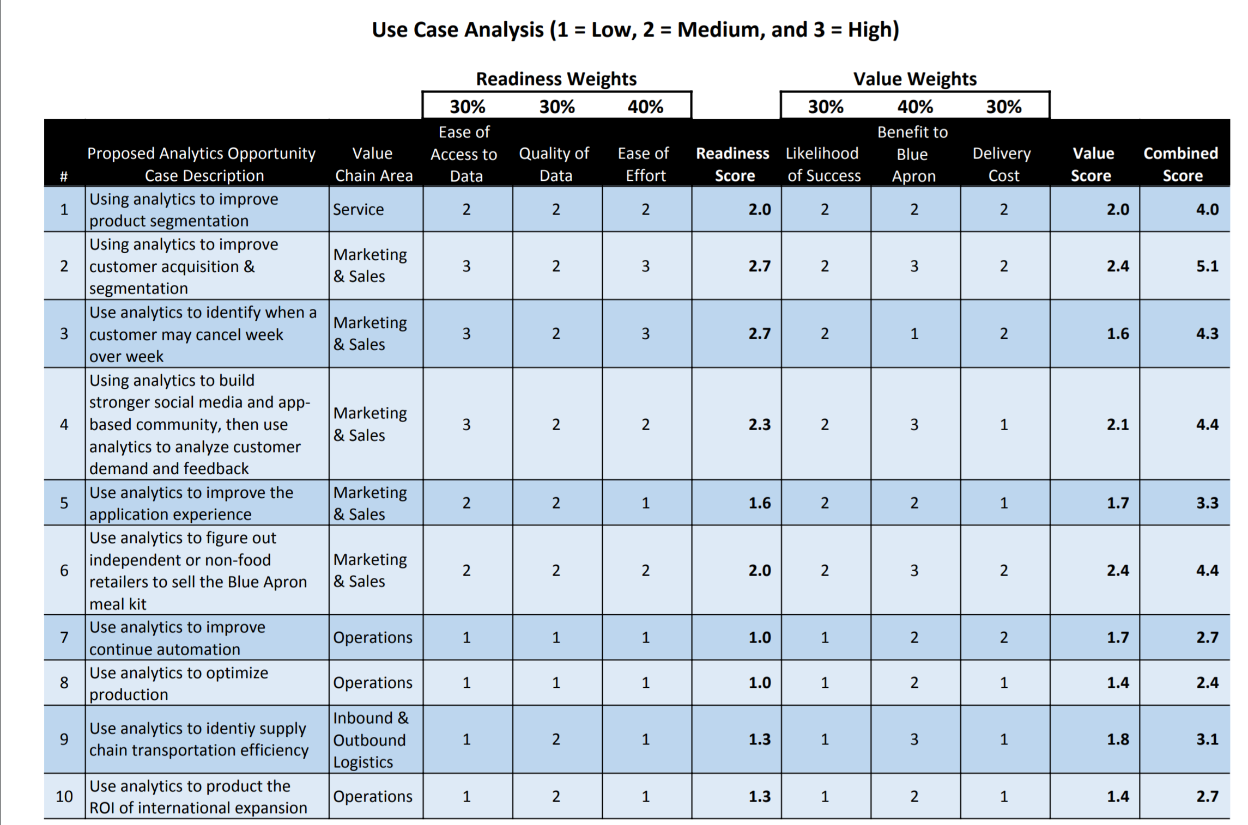
We formulated an evaluation process to narrow our options
Evaluate Value Chain
Identify Analytics Opportunities
Score Opportunities
Logistics & Operations are not the focus:
Expenses are already decreasing=pre-EBITDA profit. (See Appendix)
Marketing & Service is the focus:
Boosting Customer Base & Retention to drive revenue.
Brainstorming Ideas Drive From the Value Chain:
Used a decision chart to score the opportunities:
Identify
Our Approach
Discovery
Decision
Summary
Notes:
Carmin
As noted in the KPIs in the Appendix, our recent efforts to narrow in on the operations issues have been successful, which brings us to the biggest hurdle and the areas where we have identified our opportunities--marketing and service. Or getting customers & retaining them. Of the items of this list, how do did we narrow in on the ideas?

Slide 9
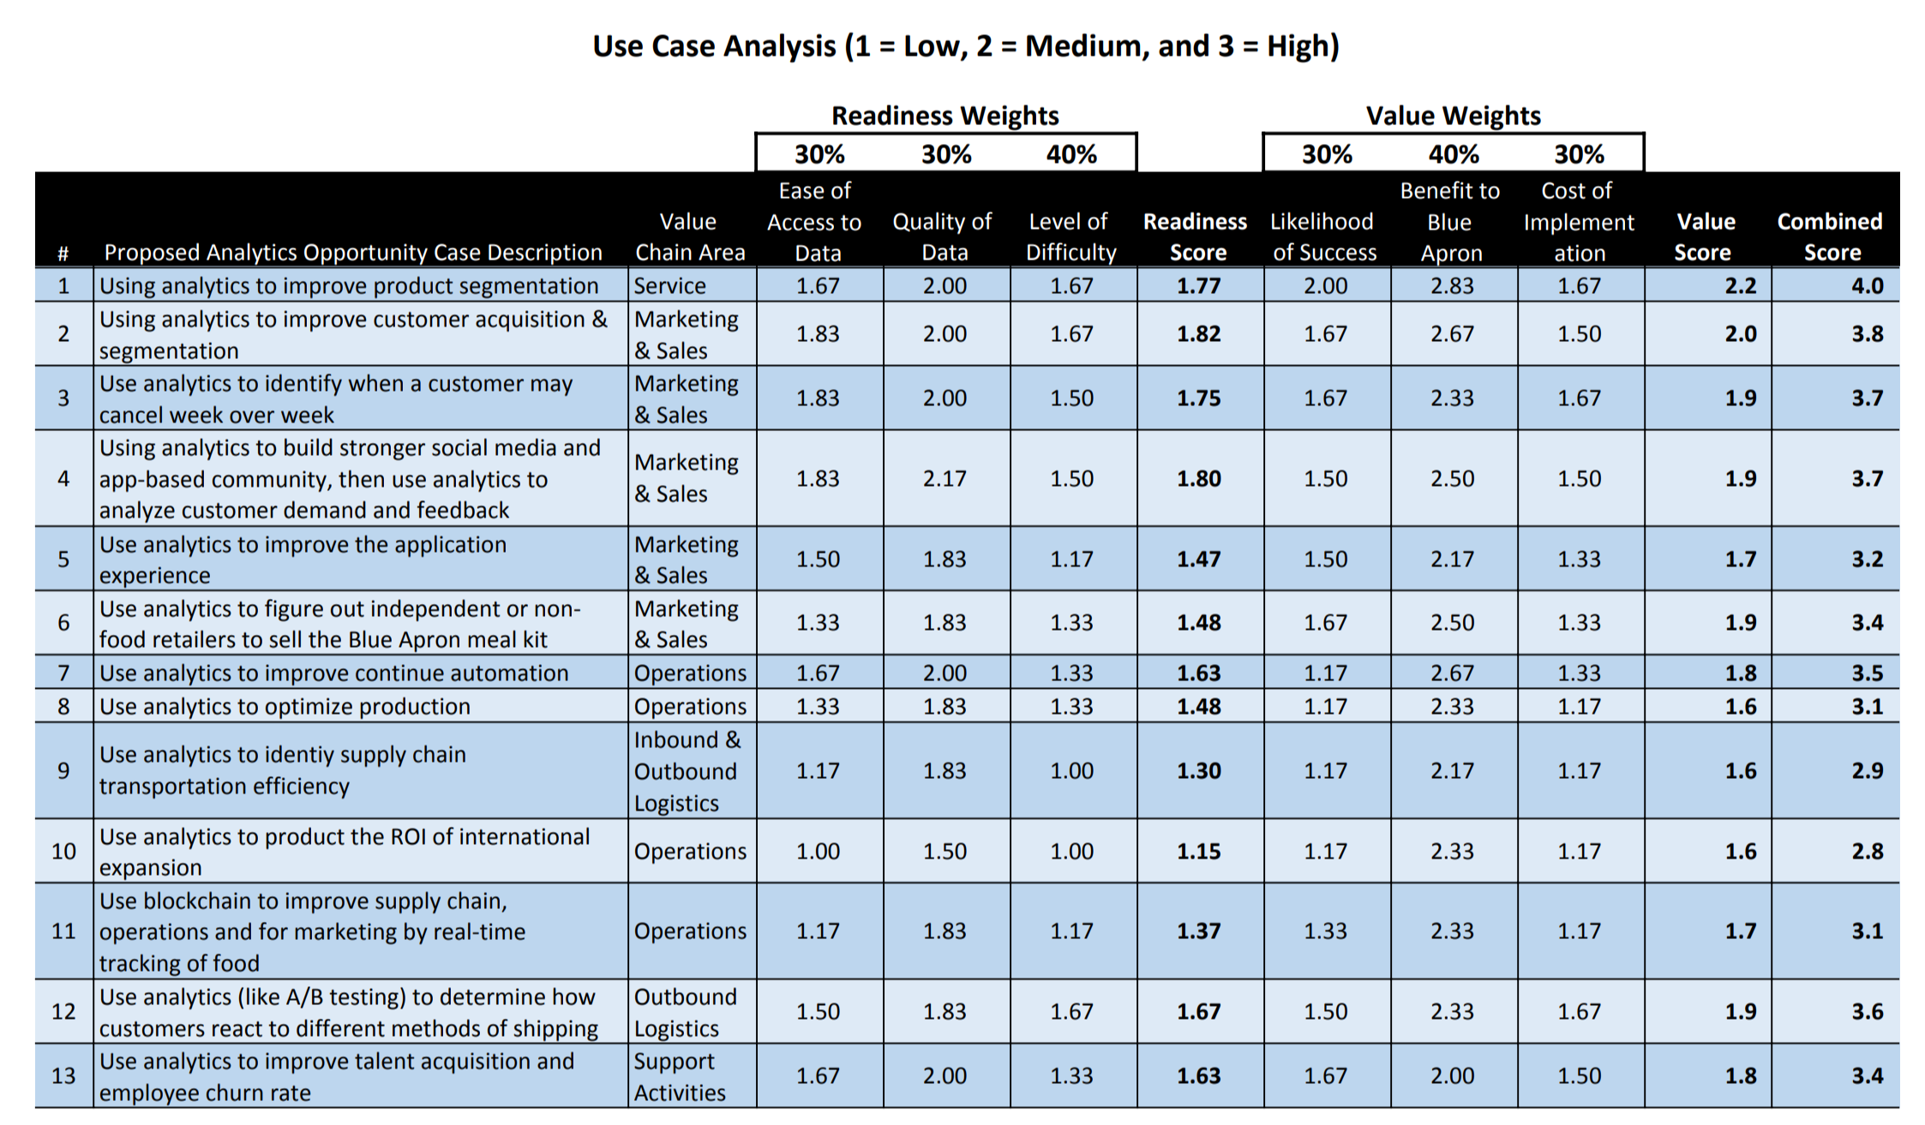
The decision matrix eliminated low-value options
Identify
Our Approach
Discovery
Decision
Summary
Notes:
Carmin
As noted in the KPIs in the Appendix, our recent efforts to narrow in on the operations issues have been successful, which brings us to the biggest hurdle and the areas where we have identified our opportunities--marketing and service. Or getting customers & retaining them. Of the items of this list, how do did we narrow in on the ideas?

Slide 10
Opportunity Discovery
Notes:
Nick

Slide 11
Opportunity 1
Customer Acquisition Dashboards
Notes:
Nick

Slide 12

Opportunity 1: Customer Acquisition Dashboards
Current State: $35 mm customer referral program (free meals)
Most new customers are referrals
Existing customers may invite others to receive complimentary meals
Acquisition costs are $150 per customer
Weaknesses:
Not all referrals become paying customers
Churn is much higher than 10% when including “free trials”
Customers stick around ~10 months
Existing customers need to be retained or replaced otherwise there will be no existing customers to refer new customers
Identify
Our Approach
Discovery
Decision
Summary
Notes:
What are they doing today?
Customer Referral Program or “Give Away Meals for Free”
Most new customers are referred by existing customers
Existing customers may invite others to receive complimentary meal delivery
Customer acquisition costs are $150 per customer
What are the weaknesses?
Not all referrals translate into paying customers
Churn is much higher than 10% if include “free trials”
Customers stick around 10 months on average
Existing customers need to be replaced or there will be no existing customers to refer new customers
What do we propose? Make sure to use analytical tool/process
The analytic opportunity points to customer retention before customer acquisition because most new customers are referrals from existing customers - I’m worried this undermines the proposed solution (recommendation system) - Sasha
New customer marketing costs include:
Advertising, TV, Social Media, Direct Mail, Radio & Podcasts, and Email.
Marketing costs are $117.5mm in 2018 or 17.6% of revenue.
Analytics can be used to more effectively target new customers
Stop giving away meals for free and target new customers
How does this improve the business?
Reduce customer acquisition costs
Turn new customers into paying customers

Slide 13
Opportunity 1: Customer Acquisition Dashboards
Current State: $35 mm customer referral program (free meals)
Most new customers are referrals
Existing customers may invite others to receive complimentary meals
Acquisition costs are $150 per customer
Weaknesses:
Not all referrals become paying customers
Churn is much higher than 10% when including “free trials”
Customers stick around ~10 months
Existing customers need to be retained or replaced otherwise there will be no existing customers to refer new customers
Proposal: Create customer acquisition analytics dashboards that...
Monitor most successful customer sources
Allows Blue Apron to target the people who are most likely to buy
Value:
Reduce customer acquisition costs
Turn new customers into paying customers
Identify
Our Approach
Discovery
Decision
Summary
Notes:
What are they doing today?
Customer Referral Program or “Give Away Meals for Free”
Most new customers are referred by existing customers
Existing customers may invite others to receive complimentary meal delivery
Customer acquisition costs are $150 per customer
What are the weaknesses?
Not all referrals translate into paying customers
Churn is much higher than 10% if include “free trials”
Customers stick around 10 months on average
Existing customers need to be replaced or there will be no existing customers to refer new customers
What do we propose? Make sure to use analytical tool/process
The analytic opportunity points to customer retention before customer acquisition because most new customers are referrals from existing customers - I’m worried this undermines the proposed solution (recommendation system) - Sasha
New customer marketing costs include:
Advertising, TV, Social Media, Direct Mail, Radio & Podcasts, and Email.
Marketing costs are $117.5mm in 2018 or 17.6% of revenue.
Analytics can be used to more effectively target new customers
Stop giving away meals for free and target new customers
How does this improve the business?
Reduce customer acquisition costs
Turn new customers into paying customers

Slide 14
Opportunity 2
Cancellation Prediction
Notes:
Nick

Slide 15
Opportunity 2: Cancellation Prediction
Current State: Analytics have primarily focused on what each customer was likely to order
Weaknesses:
Many competitors have entered the market because of low barriers to entry
Blue Apron is excelling at operational efficiency but has yet to address cancellation issues
Proposal:
Shift analytics effort from operations to customer retention
Develop model to predict cancellations a week in advance
Value:
Identify gaps in our offerings
For example, 81% of orders are 2-person plans, but 30% have children under 18
Are people leaving because we don’t have a 3-person options?
Or add-ons available?
Saves money on operations
Don’t order food for people leaving
Presents opportunity to stop the departure
Offer a favorite meal off-cycle or discount for staying
Identify
Our Approach
Discovery
Decision
Summary
Notes:
Blue Apron to date
Efforts on acquiring customers
But everyone has the same idea
Improving Operational efficiency
Have had success, but now the need is on the revenue side
Analytics have focused on what each customer was likely to order.
Doesn’t plan for people leaving, just current customers order.
What do we propose?
Shift existing advanced analytics work from operations to customer retention
Use feature importance to see who is likely to leave. -- Feel free to mention this but there wasn’t room on the slide.
How does this improve the business?
Identify gaps in our offerings
For example, 81% of orders are 2-person plans, but 30% have children under 18. Are people leaving because we don’t have a 3-person options? Or add-ons available?
Saves money on operations
Don’t order food for people leaving.
Presents opportunity to stop the departure
Offer a favorite meal off-cycle or discount for staying

Slide 16
Opportunity 3
Recommendation System
Notes:
Nick

Slide 17
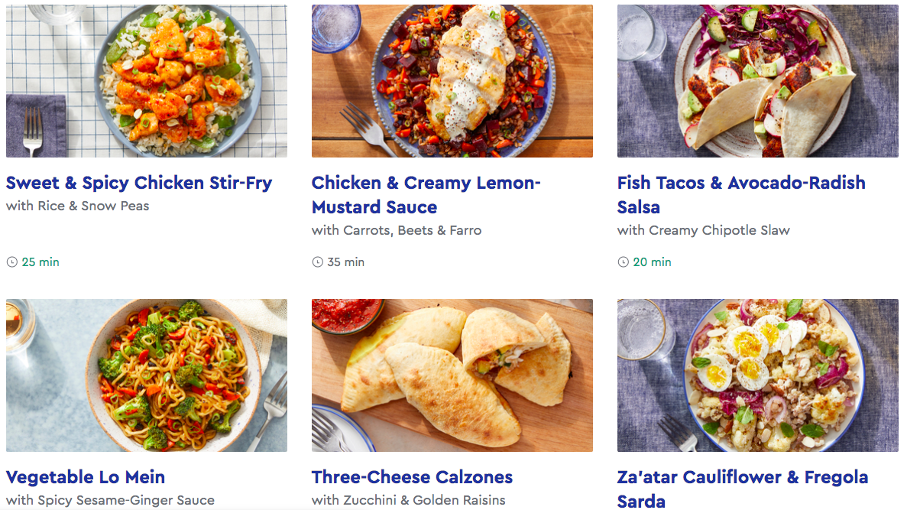
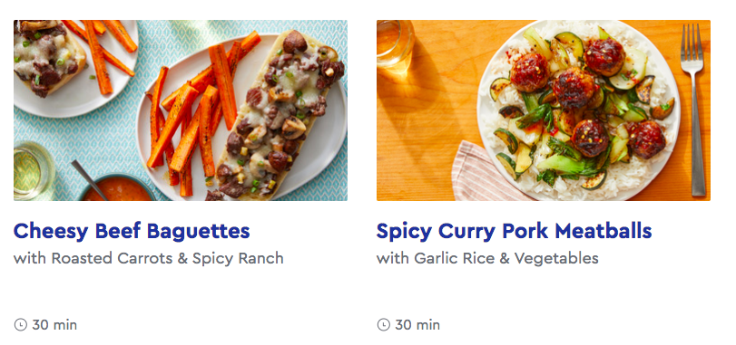
Opportunity 3: Recommendation System
Current State:
Use the same menu for all existing customers and it is not tailored to the taste of different customers; never implemented recommendation system before
Weaknesses:
The current landing page makes difficult for customers to choose what they want to it
Customers might easily become overwhelmed and choose nothing
Subsequently, customers will cancel subscription services and our revenue will also suffer
Current Menu
Don’t know what to choose
Identify
Our Approach
Discovery
Decision
Summary
Notes:
Still debating whether to choose 17&18 or 19&20

Slide 18
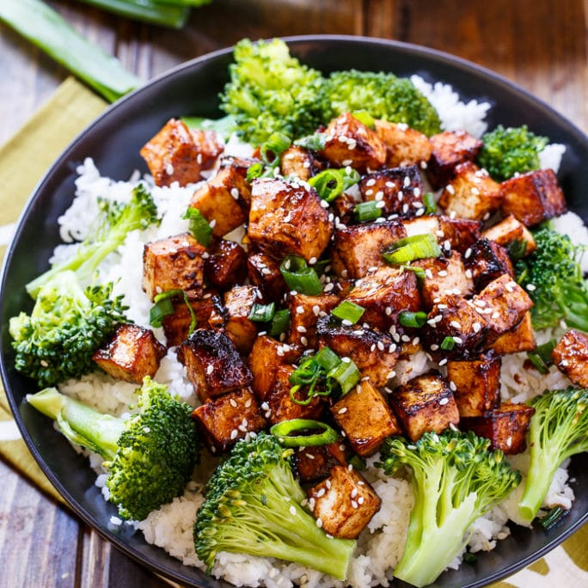
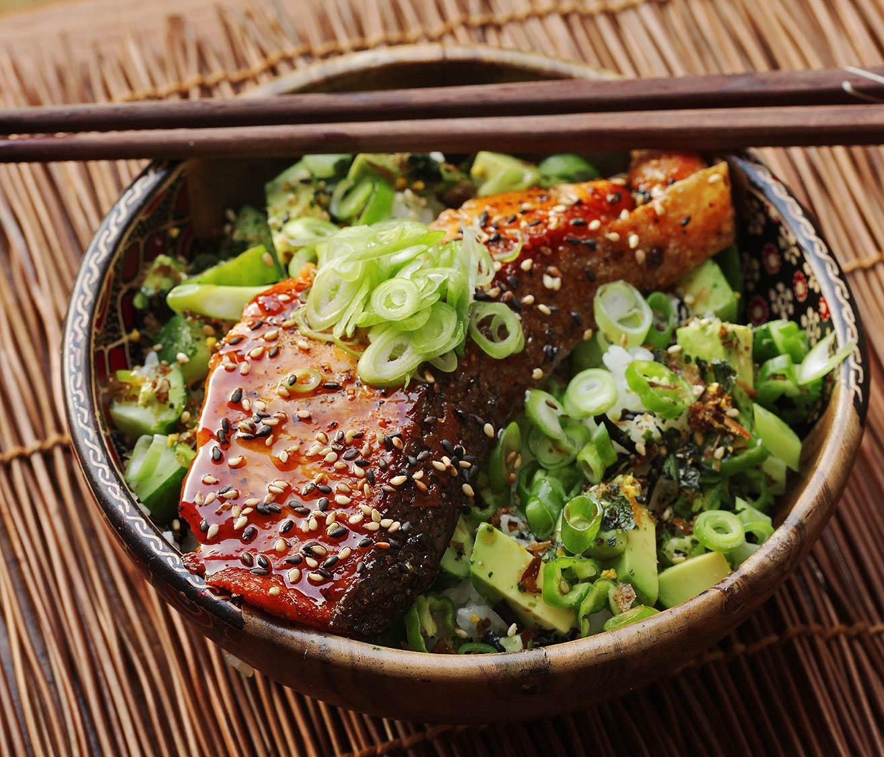
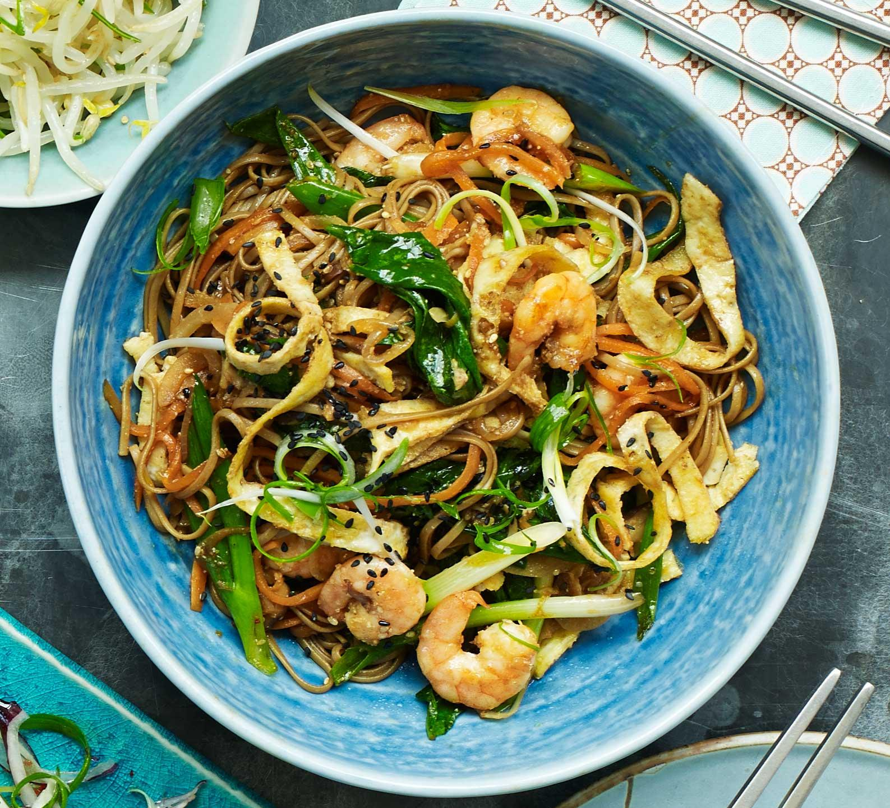
Opportunity 3: Recommendation System
Proposal:
Design Machine Learning powered recommendation system to provide personalized menu based on individuals’ preferences, taste and historical purchase data
Value:
Differentiate our brand from the rest of competitors
Improve customers’ decision making process and thus enhance revenues by selling more recipes
Proposed Menu Offering
Personal Taste
Favorite cuisine
Calorie intake
Cooking skills
Available cooking time
Food restrictions
Additional info
Your order history and recipes review
Other members with similar tastes and preferences
You get recipes for your most favorite food
Identify
Our Approach
Discovery
Decision
Summary

Slide 19
Decision
Notes:
Nick

Slide 20




We believe Opportunity 3: Recommendation System is the best opportunity. Why?
1
Ease Access of Data
& Data Quality
Data are based on customer preferences and order history, no need to gain access to expensive external data
When no order history, mine social media data for recommendations
2
Likelihood of Success &
Level Difficulty
Recommendation system has been successfully developed and deployed by many internet companies such as Netflix, Amazon, Trunk Club, LinkedIn
Have been successfully deployed in food companies such as Coca Cola
3
Benefit to Blue Apron
Create competitive advantage in the meal kit delivery industry
Increase customer satisfaction, loyalty and improve sales
4
Divert a portion of $117.5 mm marketing spend to develop recommender system
$35 mm referral program. Offering discounts of 33% instead of “free” meals saves $23 mm per year. (Actual cost will be discussed in the final presentation)
Implementation Cost
Identify
Our Approach
Discovery
Decision
Summary
Notes:
Carmin

Slide 21
Summary
Notes:
Mimi

Slide 22
Executive Summary
Opportunities narrowed down from 13 to 3 finalists
Finalists
Customer Acquisition Dashboards
Cancellation Prediction
Recommendation System
Recommendation System
Targets specific customers tastes which is the #1 reason why customers buy food products (other than price)
Customer acquisition is expensive at $150 per customer - it’s much better to retain customers and recommend targeted purchases - it increases the profitability of each customer relationship
Reduce churn which is at an unsustainable 10% per year
Funded by redirecting marketing spend
Identify
Our Approach
Discovery
Decision
Summary
Notes:
Insights & Challenges

Slide 23
Thank You
Notes:
Carmin
Default font: Arial; 20
Default color of text box: RGB(127,127,127)

Slide 24
Appendix
Notes:
Mimi

Slide 25
Value Proposition: Why are customers choosing Blue Apron?
Price - Take price as given due to competition
Taste - Eating is an experience, we need to target customer tastes
Texture - Food must not only taste good but texture needs to be satisfying
Convenience - Deliver boxes as promised, complete, and on-time
Health - Although important, food quality is the last reason customers buy
Notes:
Insights & Challenges

Slide 26
Financials
Notes:
Mimi

Slide 27
Key Q1 Financial Results
Better Q1 financial results due to:
Targeted marketing focus
Stepped-up operations efficiency
Continued expense management
KPI | 9/30/2018 | 12/31/2018 | 3/31/2019
Average Order Value | 56.79 | 58.12 | 57.15
Orders per Customer | 4.1 | 4.3 | 4.5
Avg. Revenue Per Customer | 233 | 252 | 258
Source: Blue Apron Holdings Inc, 2018 10-K SEC Filing
Notes:
KPI Definitions:
Orders
We define Orders as the number of paid orders by our Customers across our meal, wine and market products sold on our e-commerce platforms in any reporting period, inclusive of orders that may have eventually been refunded or credited to customers.
Customers
We determine our number of Customers by counting the total number of individual customers who have paid for at least one Order from Blue Apron across our meal, wine or market products sold on our e-commerce platforms in a given reporting period.
Average Order Value
We define Average Order Value as our net revenue from our meal, wine and market products sold on our e-commerce platforms in a given reporting period divided by the number of Orders in that period.
Orders per Customer
We define Orders per Customer as the number of Orders in a given reporting period divided by the number of Customers in that period.
Average Revenue per Customer
We define Average Revenue per Customer as our net revenue from our meal, wine and market products sold on our e-commerce platforms in a given reporting period divided by the number of Customers in that period.

Slide 28
Financial Overview
Balance Sheet (03/31/2019):
Total Assets: $349M
Total Liabilities: $231M
Shareholder’s Equity: $117M
Cash at 03/31/2019: $99M
Cash on hand has increased
EBITDA Income is positive:
 | 3/31/2019 | 03/31/2018
Revenue | $141,890 | $196,690
Expense | $144,920 | $266,553
Net Income | ($5,275) | ($31,665)
EBITDA | $8,601 | ($17,200)
Source: Blue Apron Holdings Inc, 201910-Q SEC Filing

Slide 29
Value Chain Details
Notes:
Mimi

Slide 30
Support Activities
Labor Force
Varied workforce,
Warehouse is largely manual labor, technology side is skilled
Technology
Founded out of Silicon Valley as a tech company has grown into a food company, but still various technology components supporting it:
Engineering-software that runs/supports supply chain operations
Front-end Software-apps & website that are consumer facing
Enterprise System-technology that supports the support activities.
Analytics & Business Insights Department’s Role
Develop critical metrics & insights
Notes:
Sasha

Slide 31
Operations
Distribution Centers are the core of Blue Apron’s operations.
Located in:
Richmond, California
Linden, NJ
Arlington, TX
Key operational principles and focus are:
Sanitation and safe food practices
Inventory Control
Warehouse safety and efficiency
Packaging concerns:
Costly
New distribution channels require new packaging
Sustainability concerns
Notes:
Sasha

Slide 32
Marketing & Sales
Brand identity
Pricing
Partnerships
Marketing channels
Customer referrals
Online media
Offline media
Customer segmentation
Customer retention
Storytelling
Notes:
Sasha

Slide 33
Marketing & Sales - Channels
Primary
Customer Referral Program
Online Media
Social Media
Podcast ads
YouTube sponsorships
Website ads
Display
Native
Sponsored reviews
Search engine optimization
Offline Media
TV
Radio
Direct mail
Experimental
Community events
Short-term NYC retail pop-up
Traveling mobile pop-up
Notes:
Sasha

Slide 34
Services
Direct Activities
Creating easy and convenient web & mobile app ordering experience
Maintaining variety in weekly recipe offerings, while tracking customer’s favorite recipes
Creating supplementary in-box and digital content for a unique kitchen experience
Establishing more accessibility of meal kits via brick-and-mortar
Indirect Activities
Ensuring quality, reliable distribution pipeline
Leveraging strategic brand partnerships to enhance overall experience
Quality Assurance
Ensuring food quality meets/exceeds customer and regulatory safety standards
Gather feedback from customers and optimize recipes to meet preferences, needs and lifestyles
Notes:
Carmin

Slide 35
Additional Opportunity
Notes:
Mimi

Slide 36
Opportunity 4: Using Analytics for customer retention
Current Situation
Chef wants to share his creations with the world
May not be what customers like
Tastes differ, not targeted to customers tastes
Change menu every week
Increases operational complexity including coordination with farmers
Mistakes are costly, e.g. food shipments not meeting quality standards
Stresses inventory management system
Improve food quality
#5 reason customers buy
Customers not willing to pay more for it
Analytics Proposal
Use data to identify customer patterns & trends
Develop customer behavioral insights
Increase customer loyalty
Deliver what customer wants
Focused advertising content
Customers share their opinions and we should listen
phone, email, social networks, Blue Apron App
Overcome cold start problem
Make recommendations without a long purchase history
Business Rationale - The path to profitability
Customer acquisition costs are high and are amortized over life of customer
Increased competition has reduced the life of a customer
Retaining customers and increasing the life of a customer increases profitability of each customer relationship
Targeting customer tastes will increase customer satisfaction and increase repeat purchases, extending the life of the customer relationship
Based on consumer patterns, we can make informed recommendations at the right time and place
Notes:
Insights & Challenges

